Slide 1
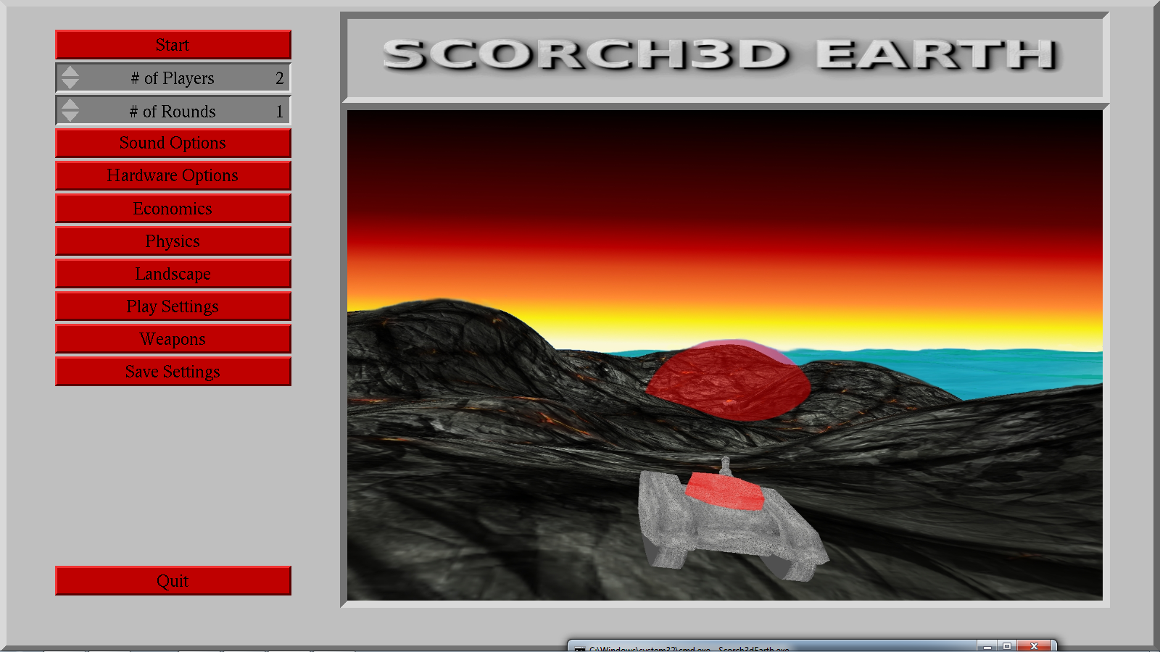

Slide 2
Group Member Names
Matthew Hoggan
Hangul Lim
David Schaffer
Davit Stepanyan

Slide 3
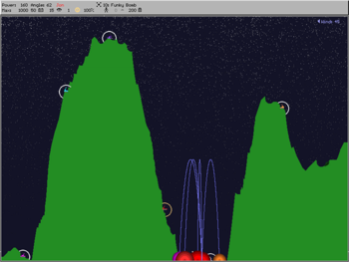
Project Statement
Problem:
Scorched Earth (3D) has not been implemented in a way that it is enjoyable by the original users of the Scorched Earth (2D). Other attempts have modified the game to such an extent that it no longer feels like the original 2D version designed for DOS.
random terrain generation
economics system
physics system
weapons system
environmental systems

Slide 4
Overview of General Terms
AC3D – This is a 3D design program which has been available since 1994.
Game Loop - The central component of any game, from a programming standpoint, is the game loop. The game loop allows the game to run smoothly regardless of a user's input or lack thereof.
Graphics Language Utility Toolkit (GLUT) – GLUT is a windowing system independent toolkit for writing OpenGL programs.
Normal Vector – This vector is often referred to as "normal," to a surface and is defined as a vector perpendicular to said surface.
OpenGL - OpenGL is the premier environment for developing portable, interactive 2D and 3D graphics applications. Since its introduction in 1992, OpenGL has become the industry's most widely used/supported 2D and 3D graphics application programming interface (API), bringing thousands of applications to a wide variety of computer platforms.
Simple Direct Media Layer - Simple DirectMedia Layer is a cross-platform multimedia library designed to provide low level access to audio, keyboard, mouse, joystick, 3D hardware via OpenGL, and 2D video framebuffer.

Slide 5
Planning and Preparation
User Requirements
Functional Requirements
User Controls, Random Terrain Generation, Economics, Turn-Based, Adjustable Physics Engine
Non-Functional Requirements
System Requirements, Tools Used
System Architecture
Discussed Later
Test Case Procedures

Slide 6
Content Management, Issue Tracking, and Documentation
http://99.116.251.16/bugzilla/
http://99.116.251.16/repos/trunk/Comp490/
http://99.116.251.16/csun/Scorch3dEarth/html/

Slide 7
Coding Standards
Use of C++ Style Memory Management
Line Wrapping Policies
Use of Curly Braces on Every If/Else Statement
Commenting Policies
Indentation Policies
File Naming Policies
Getter and Setter Policies

Slide 8
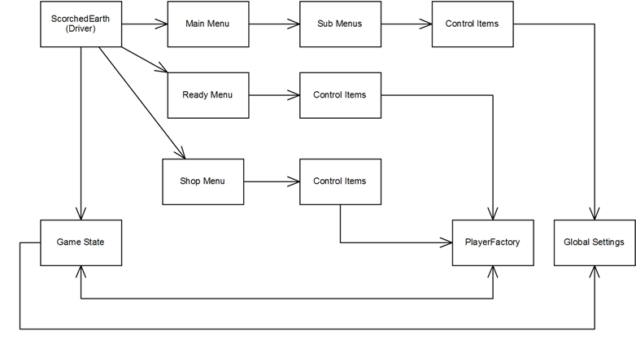
General Architecture

Slide 9
Design Patterns Used

